Slide 1
Lights, Music & LCD
CS 594 - Microprocessor-Based System Design
Fall 2018 - Group #1
Aidan Jude
Mubasshir Karim
Peter Vu
Aaron Hohler

Slide 2
Why did we choose this topic?
It seemed like something that interested our entire group
It applied to all of us in the group, because we enjoy music and lights
Adding a display on top of the music and lights was something that could challenge us
The topic overall seemed like a challenging one that we, as a group, wanted to take on and learn from

Slide 3
Our Problem Statement
What can make a boring, dull party into a fun and lit one?!?
What can take Christmas lights on a house to a whole ‘nother level?!?
What can light your world up and make you dance?!?

Slide 4
The Solution to Our Problem
When you have music synchronized with lights!
When it all lights up to a nice Christmas song!!
So we decided to design an embedded system that lights up LEDs to the music being played

Slide 5
Literature Review/Other Solutions
This problem has been addressed using solely a Arduino microcontroller. Some examples found online:
Arduino + LED strip peripheral + Individual Serial Message Entry
Arduino + LED strip peripheral + Microphone Peripheral
Arduino + MSGEQ7 IC + microphone peripheral

Slide 6
What Makes Our Solution Different?
Utilize two micros (DEMOEM & Arduino) to deliver a more versatile solution
Coordinate lighting of individual LED peripherals along with LEDs located on the DEMOEM board
Count the number of ‘hats’ (type of sound) produced by the music and display the result to the DEMOEM LCD
Concurrently display the name of the song playing on a separate LCD peripheral

Slide 7
Theory
Play music via connected computer
Utilize open source Java library ‘Processing’ to communicate the music being played to the microcontrollers via serial port communication
Software loaded on Arduino interprets serial messages and lights two LEDs, displays song name, and sends voltage to DEMOEM I/O pin
DEMOEM code reads value at LED (voltage from Arduino is connected directly to LED pin) on board and displays the updated count of the number of ‘hats’ that have occured

Slide 8
Process Flow
LED 1
LED 2
COMPUTER
DEMOEM
LED 3
LCD (count of ‘hats’)
Arduino
process.exe
Serial
LCD (name of song)

Slide 9
Materials and Their Uses
What
An Arduino board
The required DEMOEM board
External LCD
Potentiometer
Other necessities: cables, jumpers, 5mm LEDs, resistor, laptops, 9V battery, and software (codewarrior, arduino software environment, processing, music processor)
Why
We used an arduino along with the DEMOEM board because it was very user-friendly in terms of implementations and prototyping. Arduino is also much more reliable and easy to set up for development
The other materials were required or needed to make the project work.
How
Digital input sent from the Arduino to the DEMOEM board in order to display the LCD.

Slide 10
Project Uses
Entertainment systems - for social gatherings or for personal use
Raw input
No delay or volume adjustment
Pre-analyze
Home enhancement - especially with trend of smart home technology such as Amazon Echo, Google Home, etc.
Notification systems - phones already have the LED light option, but you can use this as another external notification visual when your phone is not with you.

Slide 11
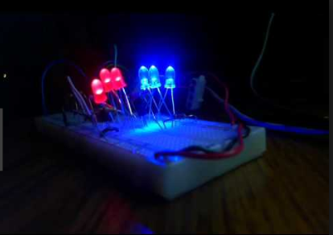
Is everyone ready for a demo?

Slide 12
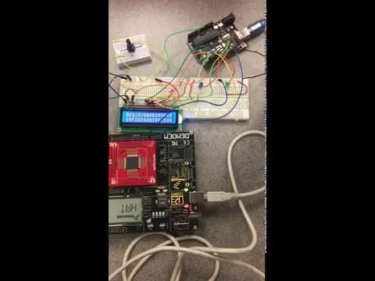

Slide 13
Where did we struggle with this project?
Hooking up arduino to the DEMOEM board in order to get the displays.
Getting everything to be compatible so that the project would actually work.
LCDs not working and then working sometimes.

Slide 14
What did we learn from this project?
We learned how to work with each other’s strengths and weaknesses.
A semester long group project always challenges our time management skills as individuals and as a group.
We learned how to succeed in this particular project using microcontrollers and can ultimately build off of this to potentially create something even better.
After dealing with microcontrollers all semester long, we learned how useful and powerful they can be.

Slide 15
References
Vamsikurre. “Simple LED Party Lights using Arduino.” Instructables.com, Instructables, 15 Oct. 2018. Web
Juveria_rk. “Music Synced LED Lamp (Using Arduino and Sound Sensor).” Instructables.com, Instructables, 15 Oct. 2018. Web
Gabb.ily. “Music Synced Flashing LEDs (Arduino & MSGEQ7).” Instructables.com, Instructables, 15 Oct. 2018. Web

Slide 16
Questions?

